Slide 1
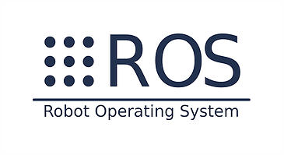

Capstone Project by
Navistar Team (Group 4)
Participants:
Cristian Valadez
Vivek Bonangi
Kiran Thorat
Amy Kofoed
Cory Packard

Slide 2

Objective
Understand and execute Sense-Think-Act in Real-Time paradigm and use it to explain how an autonomous vehicle operates. This includes but not limited to:
Robotics Operating System and its concepts
GitHub process and its real time usage
Python programming language overview and hands-on experience to code robotics design.
Mechatronics concept and implementation through python code
Simulation and visualization through Gazebo
Understanding of Lidar, sensors and Camera altogether
Machine learning concepts and its usage in designing
Navigation, SLAM concepts
Apply all these above learnings on the turtlebot vehicle.

Slide 3
Capstone project overview
Task 1A:
Wall Follow
Task 2A:
Line Follow with Object Detection
Task 3B:
Pure pursuit waypoint follow

Slide 4
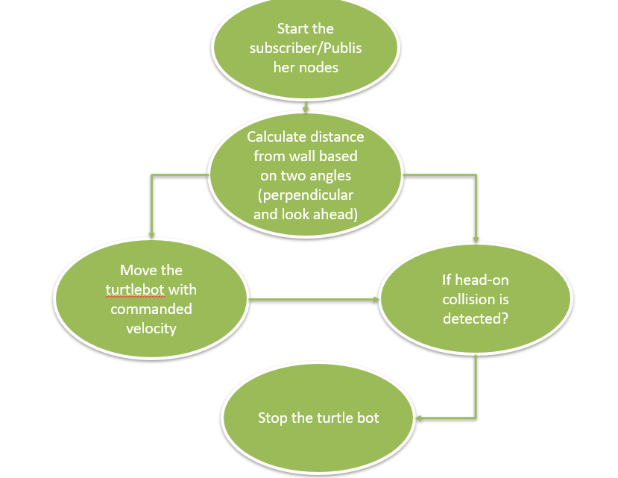
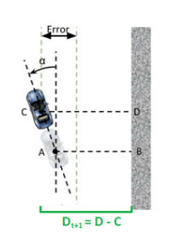
Task 1: Wall Follow
To obtain the data from Laser scan implemented subscribers and publisher node with 20Hz rate.
Using the Laser scan data, calculated distance from wall based on two angles.
Implemented a PI controller to control the speed and angular velocity of the turtle bot and avoid any imminent collision.
Some logic to detect head on collisions was added to deal with sharp turns. When a head on collision imminent is detected but wall follow is still commanding to move straight, the added logic will command robot to start turning earlier

Slide 5
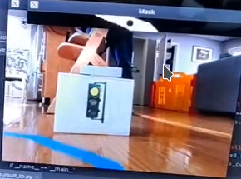
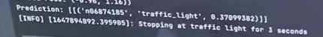
Task 2: Line following with object detection
Previous code that was developed for following the yellow line was used, but modified for blue tape color since that is material that was available
Sometimes the sun coming in from the window caused issues with detection of blue line, but using HSV to compare color allowed for fluctuations in color intensity/value to not be an issue
The traffic light was successfully detected using the Resnet50 neural network

Slide 6
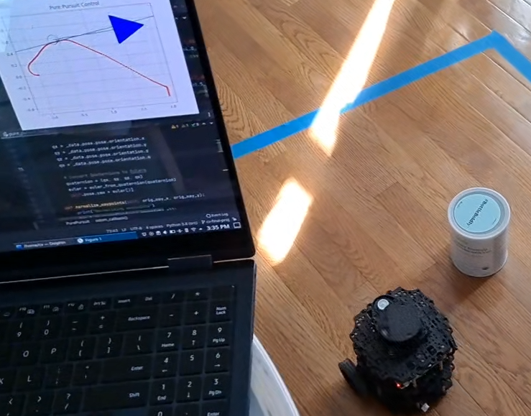
Task 3: Pure Pursuit
Pure pursuit algorithm was chosen for the waypoint following with reactive controller task
The waypoints were created to avoid certain obstacles and navigate to a final goal
Normalization logic was added to shift the waypoints that were logged to start at pose (0,0)
The pose of the turtlebot was also shifted to start at pose (0,0) at the beginning of task 3
This logic allowed for no mismatches between odometry and the position values that were logged for the waypoints

Slide 7
Challenges
Using hard coded position values to trigger when a task is finished and to start the next task provided some challenges
Zero-ing out the odometry data at the beginning of every task alleviated many issues with odometry mismatch
Working near a window caused light variation in the blue tape
Increasing the range of allowable color values in HSV fixed this issue

Slide 8
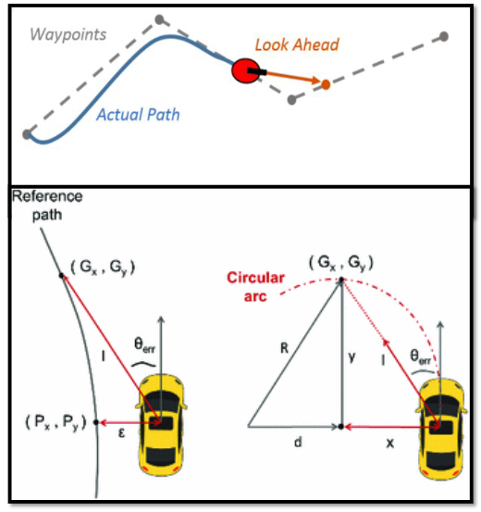
Geometric Path Tracking Controllers Misbehave
Solution: Recalculate reference point on path through mathematical model
It was observed that, vehicle was behaving weirdly while taking turn from second quadrant to third quadrant and from third quadrant to forth.
By changing angle equation and varying error calculation, it was properly encountered and fixed.

Slide 9
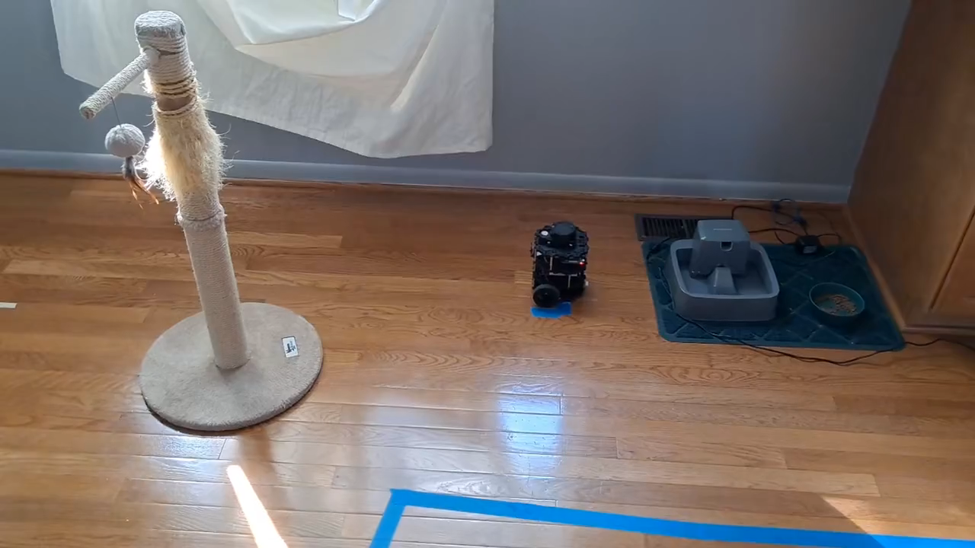
Video

Slide 10
References :
http://wiki.ros.org/navigation/Tutorials
http://www.gazebosim.org/
SLAM For Dummies (A Tutorial Approach to Simultaneous Localization and Mapping)
Sense Plan Act
https://github.com/

